Slide 1

Computational Systems Biology
Sauro* and Hellerstein+
BIOE 437/537
* Bioengineering, + eScience
University of Washington, Sept 2021

Slide 2
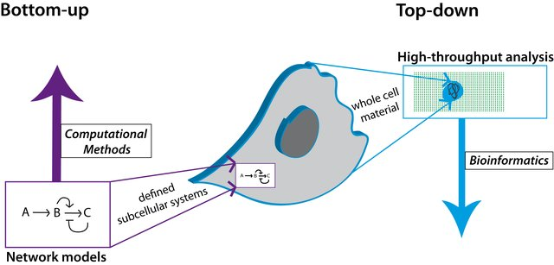
What is systems biology?
Two tracks:
Bottom-up
Top-Down
Whole-Cell Network Models
Lessons we Learned from High-Throughput and Top-Down Systems Biology Analyses about Glioma Stem Cells Current Pharmaceutical Design Mock et al (2013) 20(1) DOI: 10.2174/138161282001140113124343

Slide 3
What is systems biology?
Two tracks:
Bottom-up - Hypothesis based
Falsification of models
Mechanistic
Usually gives better understanding of how something works
Relies heavily on theory, experiment and computation
Top-Down - Discovery based
Home to machine learning
Empirical
Statistical
Poor at providing understanding
Generally theory free (other than statistical theory)
Lessons we Learned from High-Throughput and Top-Down Systems Biology Analyses about Glioma Stem Cells Current Pharmaceutical Design Mock et al (2013) 20(1) DOI: 10.2174/138161282001140113124343

Slide 4
What is systems biology?
An article that just appeared last week that highlights the importance of theory in biology to understanding:
“Data should be a means to knowledge, not an end in themselves.”
Biology must generate ideas as well as data. Nature 2021, Sept 13th, Paul Nurse

Slide 5
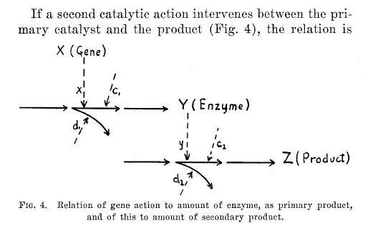
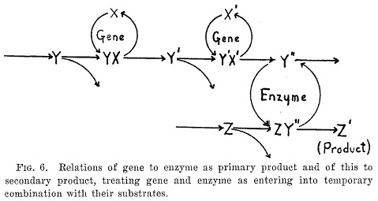
The first systems biology paper?
Wright, S. 1934. Physiological and evolutionary theories of dominance. Amer Nat 63: 25–53.

Slide 6
What kinds of questions we don’t ask in systems biology?
Find the gene responsible for coding protein x
Isolate the enzyme that catalyzes reaction y
How does enzyme w work?
What is the structure of protein u
How does protein z form a complex?
I need to find a drug that will bind protein q
A characteristic of these statements is they all involve parts, the basic working components of life but miss the big picture.

Slide 7
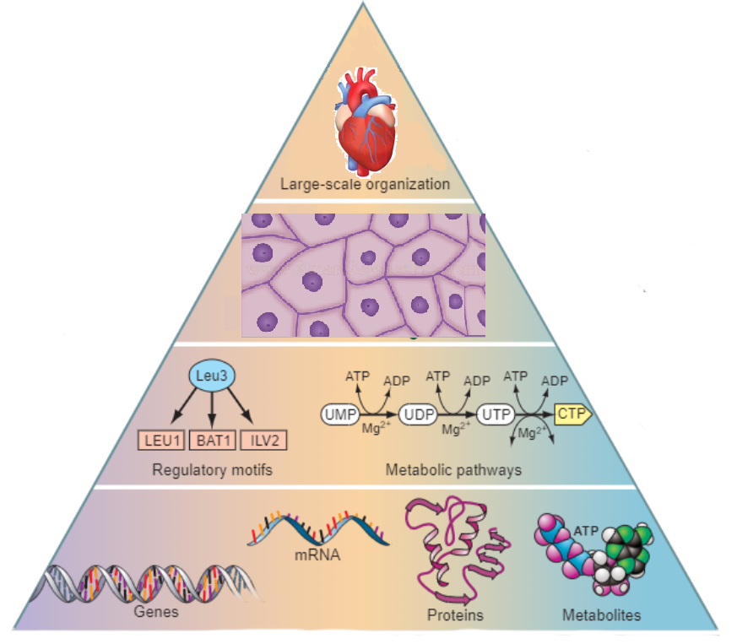
The Pyramid of Life
Systems Biology Starts here

Slide 8
The kinds of questions we do ask in systems biology
Physiology: Physiology, study of the functioning of living organisms, animal or plant, and of the functioning of their constituent tissues or cells.
We ask any question that a physiologist might ask but in a much more quantitative manner.
Why does this pathway use this feedback mechanism?
What would be a suitable target for a given disease?
What computation is any, do signaling network carry out?
How can I build a predictive model of this system?
How can I reengineer this organism to produce this valuable commodity?
What is life?

Slide 9
The difference between systems biology and….
Biochemistry Systems Biology
Study isolated components Study intact systems
Describe systems verbally or pictorially Describe systems quantitatively
Theory is generally descriptive Theory is mathematical and analysis driven
Simulation: Thought experiments Simulation: Computer software

Slide 10
Success Stories
Hodgkin-Huxley 1952: The model provides a mechanistic explanation of the propagation of action potentials in axons, based on the combined behaviours of a system of ionic channels (https://www.ncbi.nlm.nih.gov/pmc/articles/PMC1392413/)
Kacser & Burns, 1973; Heinrich & Rapoport, 1973: Completely reassessed the operating principles of how metabolic operates as a system (https://pubmed.ncbi.nlm.nih.gov/7672373/, https://pubmed.ncbi.nlm.nih.gov/4830198/)
Goldbeter and Koshland, 1981: Described how ultrasensitive (“cooperative”, although nothing cooperate here) behaviours in signalling cascade can appear without mutimeric allosteric assemblies. Second, it predicted the possible existence of MAPK cascades a decade before their discovery (https://www.pnas.org/content/78/11/6840)

Slide 11
Success Stories
Trypanosoma Model (1997): Predictive model of Trypanosoma (sleeping sickness) energy metabolism, uncovered major constraints for drug targeting. (https://pubmed.ncbi.nlm.nih.gov/9013556/)
Represillator, 2000: Built from first principles, it showed that a systems understanding could be realized in vitro. Three genes in a cycle each inhibiting the next resulting in oscillations (https://www.nature.com/articles/35002125)
Teusink 2000: One of the first predictive model of glycolysis (https://febs.onlinelibrary.wiley.com/doi/full/10.1046/j.1432-1327.2000.01527.x)
Chassagnole 2001: The first credible model of amino acid biosynthesis (https://doi.org/10.1042/bj3560433)

Slide 12
Success Stories
Curien 2009: Understanding the multitude of negative feedbacks in amino acid metabolism (https://www.embopress.org/doi/full/10.1038/msb.2009.29)
Kohl and Noble 2009: (Systems biology and the virtual physiological human Mol Syst Biol. 2009; 5: 292).There is now a reasonable model of a virtual heart (details still remain to be resolved) The model provides a mechanistic explanation of the propagation of action potentials in axons, based on the combined behaviours of a system of ionic channels (https://www.ncbi.nlm.nih.gov/pmc/articles/PMC2724980/)
Smallbone 2013: A iteration of Teusink’s model, even better at predicting glycolysis (https://pubmed.ncbi.nlm.nih.gov/23831062/)
Snoep 2015: Very well validated model of Malaria energy metabolism (https://pubmed.ncbi.nlm.nih.gov/25693925/)

Slide 13
Systems Biology is Cross-Disciplinary
Biology: Obviously you need to know biology, preferably cell biology, molecular biology and biochemistry.
Mathematics: Calculus, Linear Algebra and Statistics
Control Theory: teaching us control and regulation is achieved in systems. Helps us understand feedback structure
Dynamic Systems: Organism change in time, understanding dynamics, stability etc is clearly important.
Models: Build mathematical models, understand limitations of models, assumptions etc. Understand the importance of testing models and how to publish models.
Working with Experimentalists and knowing what they can and cannot do.

Slide 14
Thought Provoking Reads
Lazebnik 2002: Can a biologist fix a radio?—Or, what I learned while studying apoptosis (https://www.cell.com/cancer-cell/pdf/S1535-6108(02)00133-2.pdf)
Essentially accuses molecular biologists of studying parts of biology which are unimportant to answer the big questions. For example, if a biologists were to study a radio they would do things like catalog the colors and shapes of the capacitor rather than attempt to understand what the circuit actually did. They would end up with vaast catalog of components, capacitors, resistors, transistors, coils etc) from all kinds of radios, but fail to understand what a radio did.

Slide 15
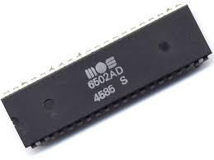
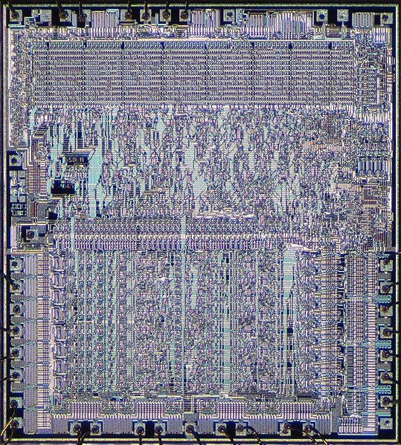
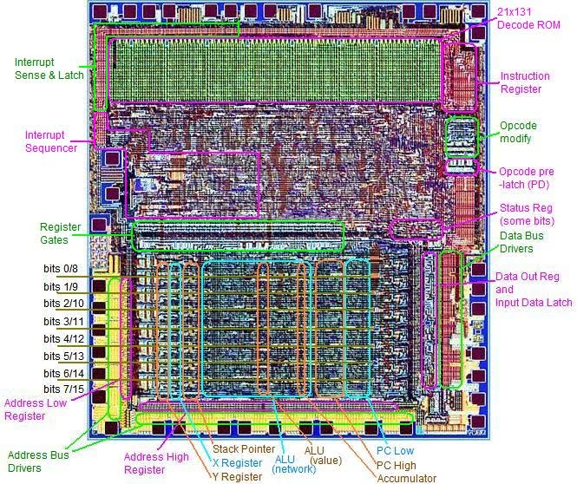
Thought Provoking Reads
Jonas and Kording 2017: Could a Neuroscientist Understand a Microprocessor?(https://journals.plos.org/ploscompbiol/article?id=10.1371/journal.pcbi.1005268)
Spoiler alert! The answers is no, at least not with the current mindset. A neuroscience would measure the electrical impulses at various points and would apply ‘mutations’ (break transistors) to see what would happen, they would conclude that certain transistors are associated with particular video games. They fail to understand the inherent hierarchical structure there in in a microprocessor and cannot to come up with any ‘theory’ of microprocessors.

